Slide 1


BWISE
SAP BUSINESS ONE
B1 - BWISE
TM

Slide 2
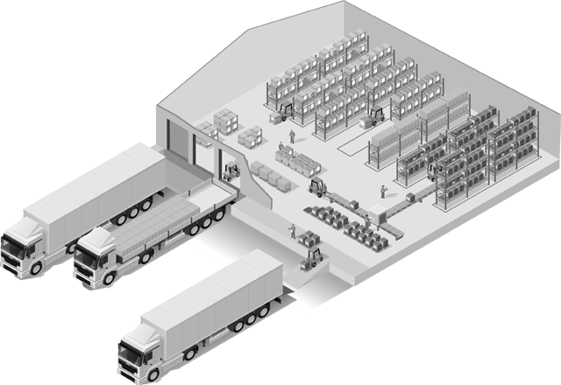
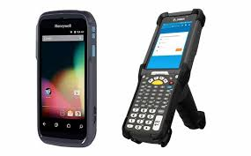
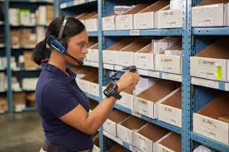
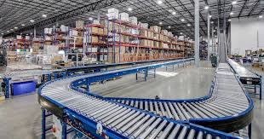
WISE Introduction
Improve your warehouse operations and increase efficiencies
WISE - Warehouse Information System Expert
Rule based system
Directed operations
Task verification
RFID, voice and mobile technology
Flexible to meet all warehouse operation flows
Inventory Management
Outbound
Inbound
SAP Business One – B1WISE WMS

Slide 3
WISE Introduction
Map your Warehouse
Warehouse
Area
WISE is the core of your Supply Chain activity
Warehouse needs solved
Improves inventory accuracy
Increases inventory turnover
Lowers inventory levels
Improves order throughput
Reduces response times
Integrates easily to other systems
Zone
Location
SAP Business One – B1WISE WMS

Slide 4
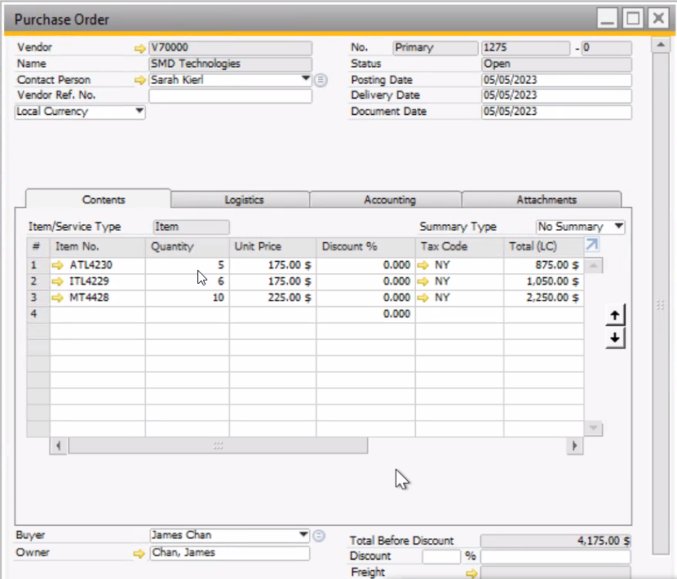
SAP Business One with WISE
Manage Your Warehouse with a Rules Based and Tasks Oriented System
Task Available
Receiving
Task Available
Receiving
DEMO167
DEMO245
DEMO389
DEMO167
Task Available
Receiving
DEMO245
DEMO389
DEMO167
DEMO245
DEMO389
SAP Business One – B1WISE WMS

Slide 5

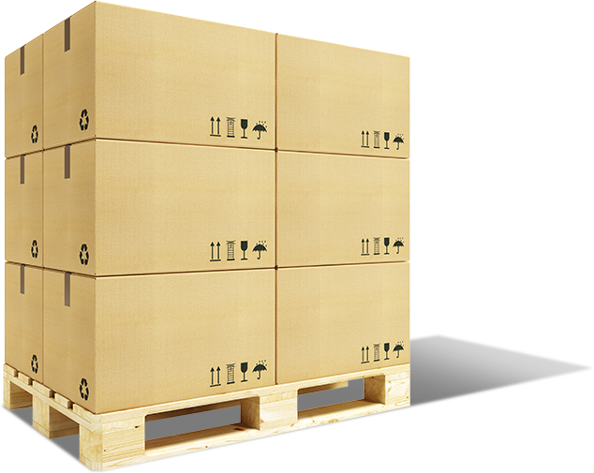
WMS Walk Through
Manage Your Warehouse with a Rules Based and Tasks Oriented System
11289067
11289068
11289069
Task Assigned
Receiving
SAP Business One – B1WISE WMS

Slide 6
WMS Walk Through
Manage Your Warehouse with a Rules Based and Tasks Oriented System
Task Completed
Receiving
88964
88965
11289067
SAP Business One – B1WISE WMS

Slide 7
WMS Walk Through
Manage Your Warehouse with a Rules Based and Tasks Oriented System
Lot#: 220301
Reference: 149667
PO#: 1292
Note:
Do not stack more than 4 cases high.
ItemID:
CM117-0150-G2
Brand:
CRD
Task Completed
Receiving
Description:
Avanti White Grade 2
88964
88965
PackID:
11289067
11289067
SAP Business One – BWISE WMS

Slide 8
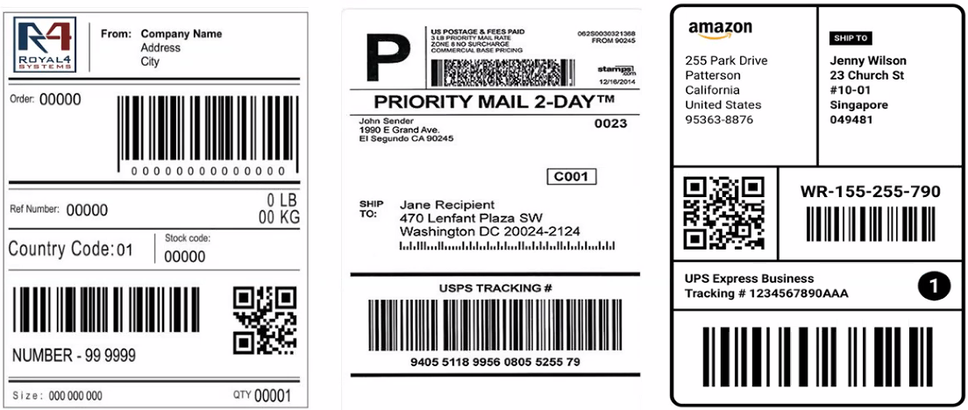
WMS Progress Check
Where is your product? Has it arrived at your warehouse yet?
Task Completed
88964
88965
88966
SAP Business One – BWISE WMS

Slide 9
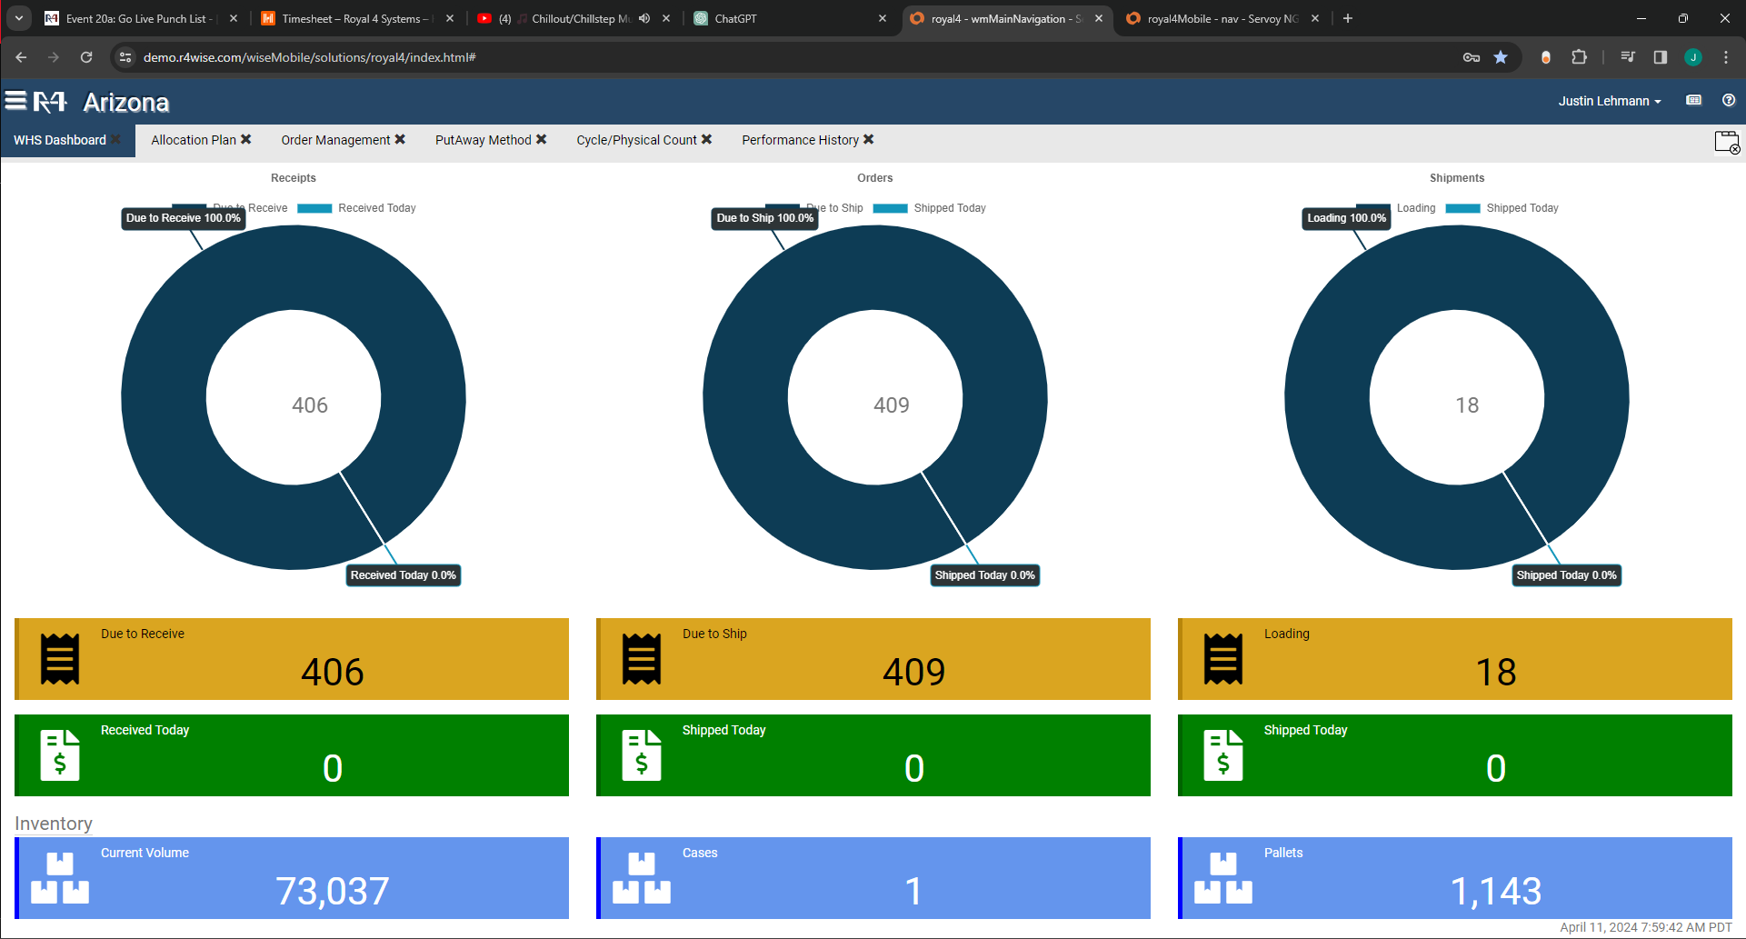
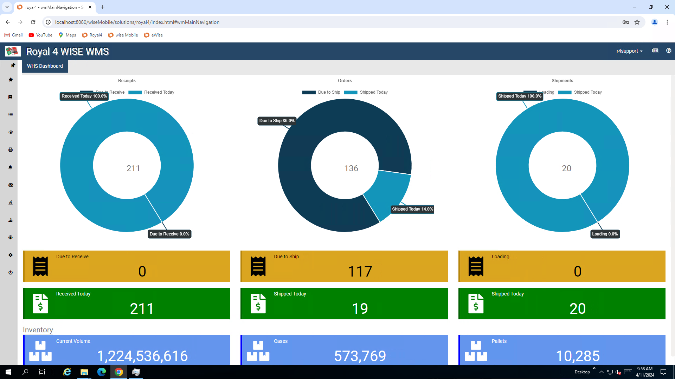

Slide 10
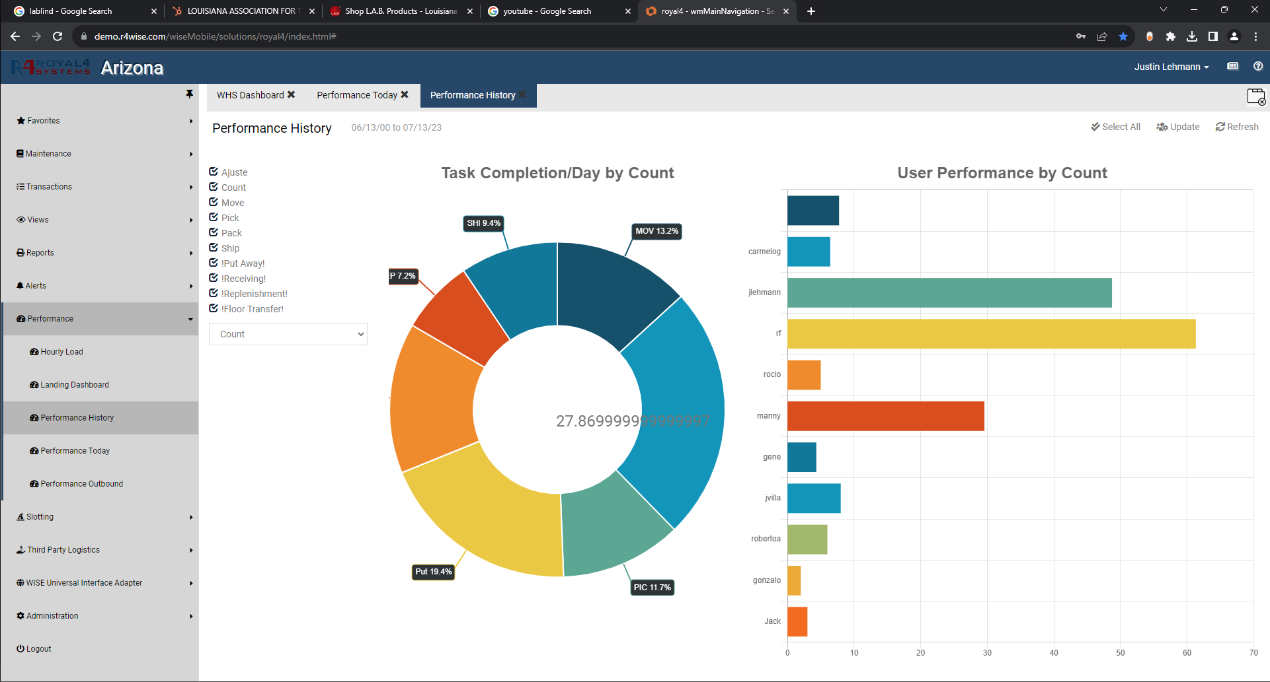

Slide 11
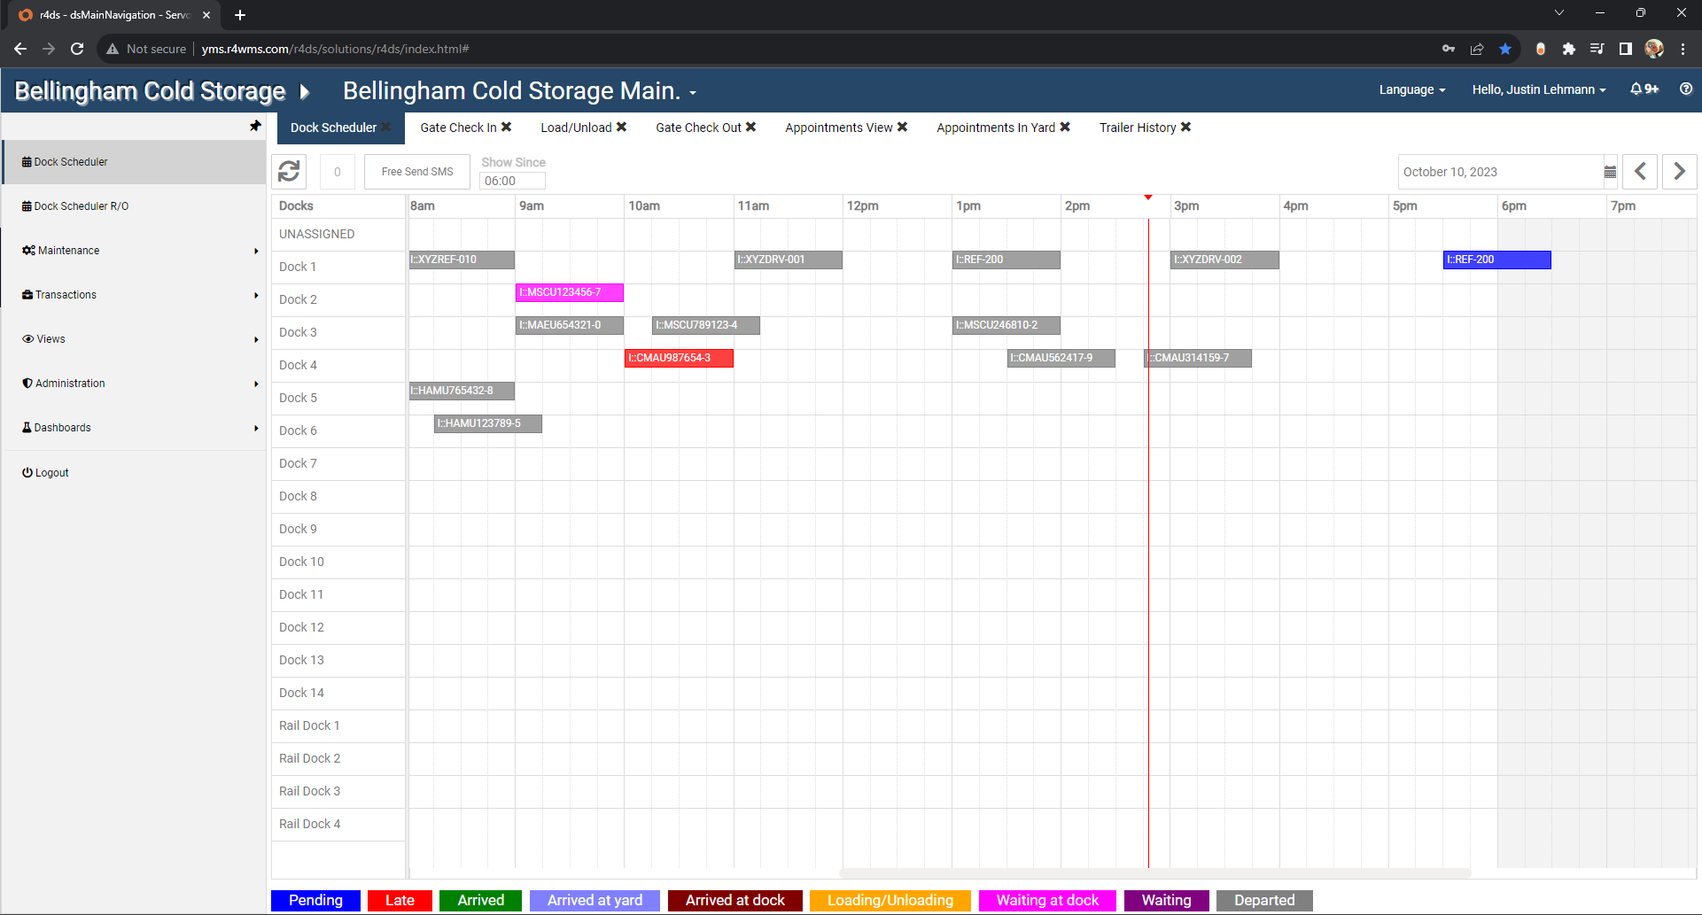
Your Company

Slide 12


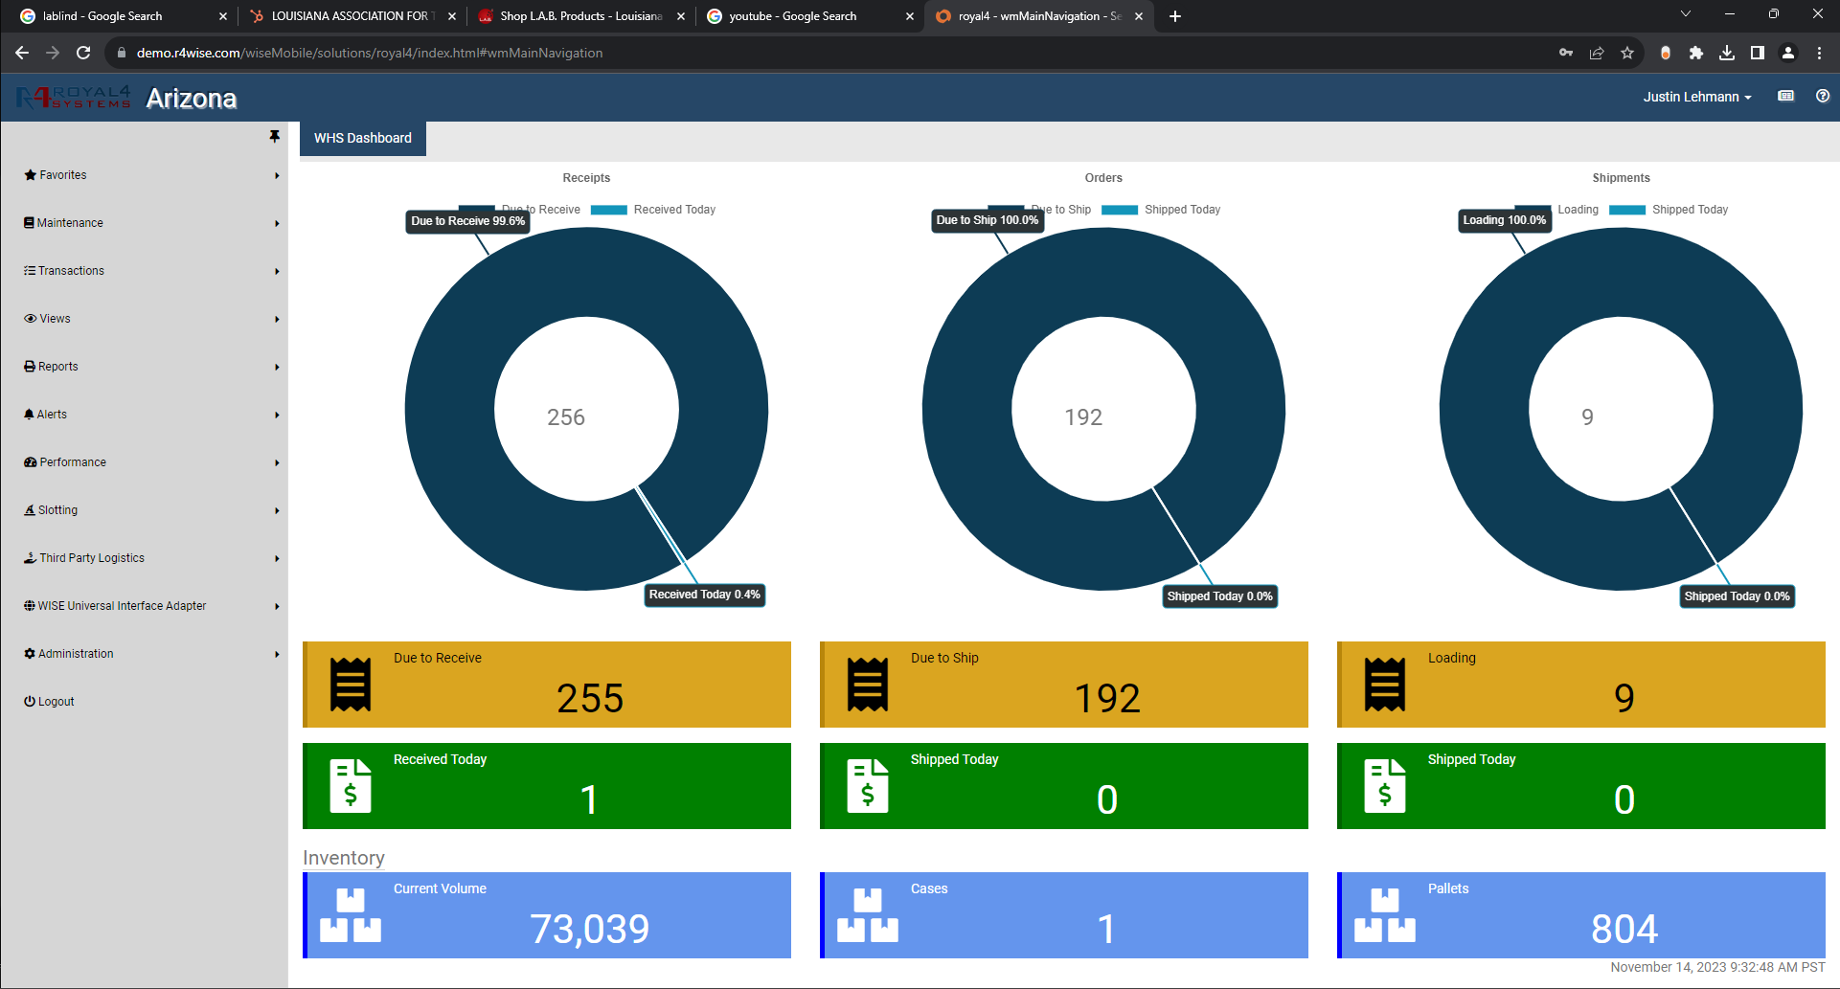
Your Company

Slide 14

BWISE
SAP BUSINESS ONE
B1 - BWISE
TM

